Slide 1
Natural Language Processing Question Answering
Sudeshna Sarkar
17 Oct 2019

Slide 2
Question Answering
Niranjan Balasubramanian
Many Slides from:
Sanda Harabagiu, Tao Yang
Chris Manning, David Ferrucci,
Watson Team, and Paul Fodor

Slide 3
Outline
Question Answering
Types of QA tasks and approaches
Reading-based QA
A General Architecture
Systems
AskMSR
FALCON
Watson
QA over Structured Databases
Semantic parsing
Reasoning focused Systems
Graph-based reasoning
Probabilistic + Logical Reasoning

Slide 4
Why is question answering interesting?
Often we are interested in just answers and not documents.
Who won the 2015 Super Bowl?
How tall is Taylor Swift?
Is Tom Hanks married?
What are two states that share a border with New York?
Concise answers can be useful for todays mobile world.
Useful benchmark for AI
Can be used as a test of knowledge and understanding.

Slide 5
Types of Question Answering Tasks
Text-based Question Answering
Closed corpus
Open-domain and Web-based
Community-based
Reading comprehension (MC-SAT from MSR)
Standardized Exams (4th Grade Science Exams from AI2)
Question Answering Over Structured Databases
Specialized domains (e.g., Geographic Databases)
Large-scale open-domain (e.g., Freebase)

Slide 6


How can we get computers to answer questions?
Pre-constructed Knowledge
On-demand reading
Reasoning

Slide 7
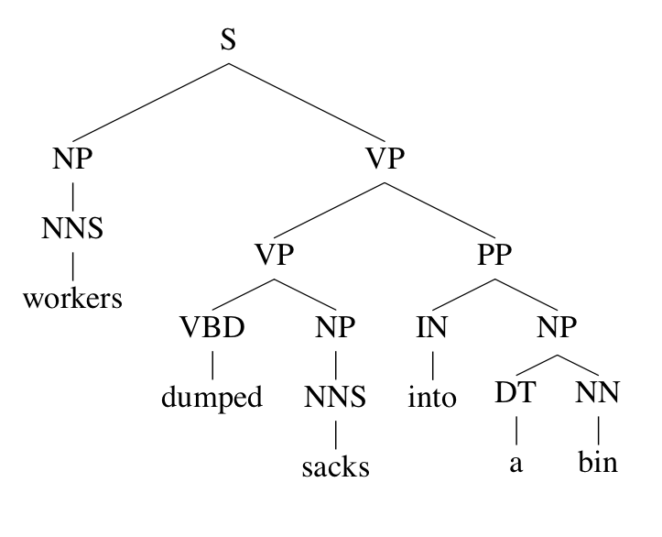
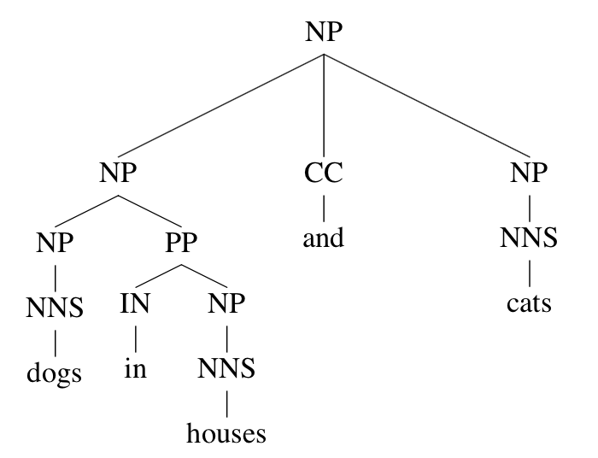
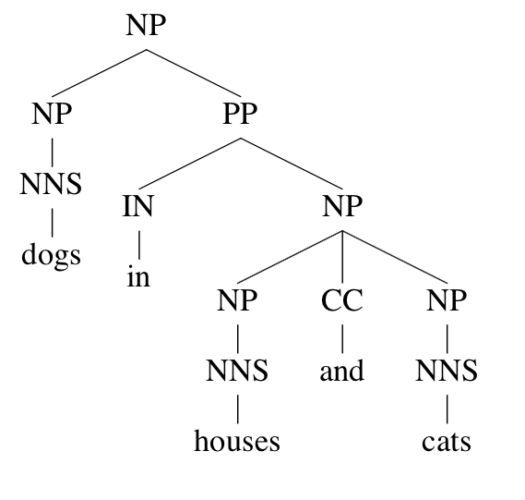
Reading-based QA from unstructured texts
Question Text
Search
+ Scoring
Answers

Slide 8
QA over Structured Data
Relational Query
Question Text
Relational Query Engine
Answers
Who discovered DNA → SELECT * from discoveries where discovery=“DNA”

Slide 9
Reasoning-based QA
Question Text
Logical Form
Logical Reasoning
Answers
Logical Forms
Does an iron nail conduct electricity?
metallic objects conduct electricity
iron nail is made of iron => iron nail is a metallic object
metallic objects conduct electricity ^ iron nail is a metallic object
=> iron nail conducts electricity.

Slide 10
Reading-based QA Approaches
Key Idea
Look up text that is likely to contain the answer and locate the answer.
Key Challenges
Finding which text bits are likely to contain the answer.
Finding the answer given a piece of text.
Benefits
Doesn’t rely on any particular format for knowledge.
Can use any text-based source.
Much of our knowledge is in textual form still.
Disadvantages
Large textual sources can be problematic because of spurious matches.
Need scalable solutions.

Slide 11
Reading-based QA: Architecture
Question
Answers
Question Processing
Search
Answer Extraction
Answer Scoring
Question Templates
Corpus
Taxonomic
Resources
Resources

Slide 12
Question Processing
What is the tallest mountain in the world?
Question Processing
Question Type: WHAT
Answer Type: MOUNTAIN
Keywords: tallest, mountain, world

Slide 13
Question Type Identification
Knowing question type helps in many ways.
-- Provides a way to filter out many candidates.
-- Often type specific matching and handling are implemented.
Class 1 | Answer: single datum or list of items C: who, when, where, how (old, much, large)
Class 2 | A: multi-sentence C: extract from multiple sentences
Class 3 | A: across several texts C: comparative/contrastive
Class 4 | A: an analysis of retrieved information C: synthesized coherently from several retrieved fragments
Class 5 | A: result of reasoning C: word/domain knowledge and common sense reasoning

Slide 14
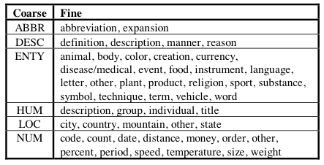
Question Type Identification
Hand-generated patterns
When … => Date/Time type question
Where … => Location type question
Supervised Classification

Slide 15
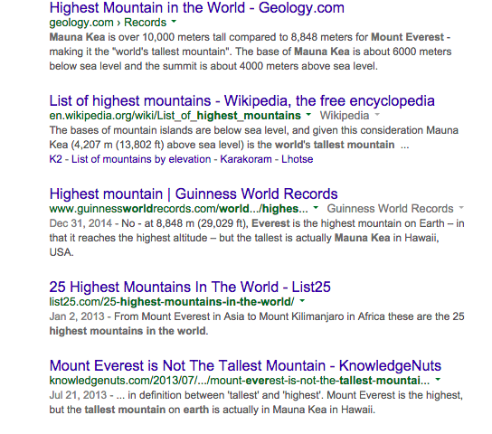
Search
Question Type: WHAT
Answer Type: MOUNTAIN
Keywords: tallest, mountain, world
Corpus
Search

Slide 16
Search
Key benefit: limit the amount of passages to search.
Deeper matching approaches are often much slower.
Typical approach: use keywords-based query.
Remove stop words, perform stemming etc.
Different from document retrieval
Passages are often short (same smoothing techniques don’t work well).
Lexical variability is especially thorny when dealing with short passages.
Often passages are filtered or scored lower for not matching the answer type.

Slide 17
Answer Extraction
Question Type: WHAT
Answer Type: MOUNTAIN
Keywords: tallest, mountain, world
Answer
Extraction
[Mount Everest] is called the world's highest mountain because it has the highest elevation above sea level.
[Mauna Kea] is over 10,000 meters tall compared to 8,848 meters for Mount Everest - making it the "world's tallest mountain".
However, [Chimborazo] has the distinction of being the ""highest mountain above Earth's center".

Slide 18
Answer Extraction
Question type and Answer type guide extraction.
“Where …” questions candidates are typically locations.
You can learn the question type to answer type mapping from data.
A standard back-off is to consider all noun phrases in the passage or sentence.
With additional pruning tricks (e.g., remove pronouns).
Sequence labeling problem
i.e., predict a sequence of ANSWER labels in sentences.
Over generation is the norm.
Don’t want to miss answers.
We’ve already pruned the search space to a small set of passages.

Slide 19
Answer Scoring
[Mount Everest] is called the world's highest mountain because it has the highest elevation above sea level.
[Mauna Kea] is over 10,000 meters tall compared to 8,848 meters for Mount Everest - making it the "world's tallest mountain".
However, [Chimborazo] has the distinction of being the “highest mountain above Earth's center".
Answer
Scoring
Question Type: WHAT
Answer Type: MOUNTAIN
Keywords: tallest, mountain, world
0.9 Mauna Kea
0.5 Mount Everest
0.3 Chimborazo

Slide 20
Answer Scoring
Most critical component of most QA systems.
Frequency based solutions when using large scale collections such as web.
State-of-the-art is to use supervised learning over many features.
BOW similarity between question and context around answer.
Syntactic similarity
Semantic similarity
Graph-matching
Learning to Rank approach used by Watson.

Slide 21
AskMSR: A Shallow QA Approach
Use the web!
Extracting answers from a single document is difficult.
Language in document may be quite different from the question.
Web contains the same information repeated in many different ways.
Higher chance that the question language might match some document.
If the same answer is extracted from multiple documents, then it is likely correct.

Slide 22
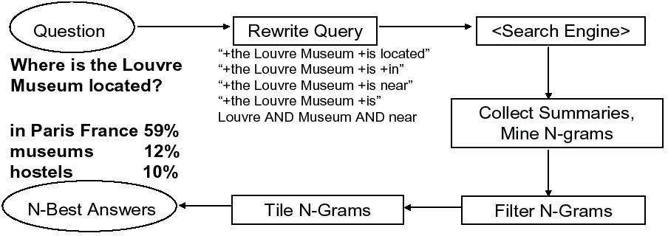
AskMSR: System Architecture
Question Processing
Search
1
2
3
5
4
Answer Scoring
Answer Extraction

Slide 23
AskMSR: Question Processing
Intuition
Questions and answers are quite close to each other in syntactic constructions.
Questions can be transformed into answer extraction patterns.
Q: Where is the Louvre Museum located?
A: The Louvre Museum is located in Paris
A: The Louvre Museum located in Paris is one of the best.
Q: Where is the Louvre Museum located?
A: Louvre Museum is located .. [ANSWER]
A: The location of the Louvre Museum located is [ANSWER]

Slide 24
Question Processing: Rewrite Patterns
Question
Q v w1 w2 …?
Rewrite Patterns
[“v w1 w2 w3 …”, L]
[“w1 v w2 w3 …”, R]
[“w1 w2 v w3 …”, R]
…
[v w1 w2 w3 …, E]
Question:
Where is the Louvre located?
Rewrite Patterns:
[“is the Louvre Museum located”, L]
[“the is Louvre Museum located”, R]
[“the Louvre is Museum located”, R]
…
[ the Louvre Museum is located, E]
1) Move the verb through each position in the question.
2) Add a back-off query that is simply an AND of all non stop word terms.
To cover patterns that include non-question words.
3) Specify where the answer is located.
Heuristic left/right/either.
Some of these patterns are nonsensical.
Don’t care as long as no bad answers are produced!

Slide 25
Question Processing: Rewrite Patterns
Question:
Where is the Louvre located?
Rewrite Patterns:
[“is the Louvre Museum located”, L]
[“the is Louvre Museum located”, R]
[“the Louvre is Museum located”, R]
…
[ the Louvre Museum is located, E]
Not all patterns are equal:
High precision low coverage.
Low precision high coverage.
Can weight patterns!

Slide 26
AskMSR: Search
Send all rewrites to a Web search engine
Retrieve top N answers (say 100)
For speed, rely just on search engine’s “snippets”
Not the full text of the actual document.

Slide 27
AskMSR: Answer Extraction
Intuition
Factoid answers are likely to be short phrases.
Mine N-Grams and filter it to fit the expected answer types.

Slide 28
Answer Extraction: Mining N-Grams
Simple: Enumerate N-grams (N=1,2,3 say) in all retrieved snippets
Use hash table and other fancy footwork to make this efficient
Weight of an n-gram:
occurrence count, each weighted by “reliability” (weight)
of rewrite that fetched the document
“Who created the character of Scrooge?”
Dickens - 117
Christmas Carol - 78
Charles Dickens - 75
Disney - 72
Carl Banks - 54
A Christmas - 41
Christmas Carol - 45
Uncle - 31

Slide 29
Answer Extraction: Filtering N-Grams
Use “data-type filters” = regular expressions to remove answers that don’t meet expected answer types.
When… [Date]
Where… [Location]
What … [Date, Location]
Who … [Person]
Boost score of n-grams that do match data types.
Lower score of n-grams that don’t match data types.
“Who created the character of Scrooge?”
Dickens – 117 * 5
Charles Dickens – 75 * 5
Disney – 72 * 5
Carl Banks – 54 * 5
Uncle – 31 * 5
A Christmas – 41 * 2
Christmas Carol – 45 * 2

Slide 30
Answer Variability
Issue
Answer maybe in expressed in different ways.
Counts get distributed.
“Who created the character of Scrooge?”
Dickens – 117 * 5
Charles Dickens – 75 * 5
Disney – 72 * 5
Carl Banks – 54 * 5
Uncle – 31 * 5
…
Mr. Dickens – 10 * 5
…
Mr. Charles Dickens – 5 * 5
A Christmas – 41 * 2
Christmas Carol – 45 * 2
Solution: Tiling
Merge sequences A B and B C to form A B C with
aggregated count.

Slide 31
Answer Scoring: Tiling the Answers
Scores
20
15
10
merged, discard old n-grams
Charles Dickens
Dickens
Mr Charles
Score 45
Mr Charles Dickens
N-Grams
tile highest-scoring n-gram
N-Grams
Repeat, until no more overlap

Slide 32
TREC QA Dataset
900 fact-based questions,
A bit over million documents consisting of news articles.
1. Who is the author of the book, "The Iron Lady: A Biography of Margaret Thatcher"?
2. What was the monetary value of the Nobel Peace Prize in 1989?
3. What does the Peugeot company manufacture?
4. How much did Mercury spend on advertising in 1993?
5. What is the name of the managing director of Apricot Computer?
6. Why did David Koresh ask the FBI for a word processor?
7. What is the name of the rare neurological disease with symptoms such as: involuntary movements (tics), swearing, and incoherent vocalizations (grunts, shouts, etc.)?
Notes:
Mozart was born in 1756.
The reason for wanting only exact answers to be returned, is to get systems to accurately pinpoint the answer within the text.
Systems can then provide as much context as the user requests, but to return context you need to know the extent of the answer within the text,
i.e. exactly what piece of text constitutes just the answer and nothing else.

Slide 33
Evaluation
Measures
Mean Reciprocal Rank (MRR) scoring with ranked answers:
1, 0.5, 0.33, 0.25, 0.2, 0 for 1, 2, 3, 4, 5, 6+ doc
Precision/Recall/F1 with Single exact answer
Discrepancies
Gold answers can be incomplete.
System provided answers can be lexically different from gold answers.
e.g., Mt. Everest, Mount Everest, Everest
Notes:
Mozart was born in 1756.
The reason for wanting only exact answers to be returned, is to get systems to accurately pinpoint the answer within the text.
Systems can then provide as much context as the user requests, but to return context you need to know the extent of the answer within the text,
i.e. exactly what piece of text constitutes just the answer and nothing else.

Slide 34
Results
Technique doesn’t do too well (in top 9 of ~30 participants!)
MRR = 0.262 (ie, right answered ranked about #4-#5)
Using the Web as a whole, not just TREC’s 1M documents…
MRR = 0.42 (ie, on average, right answer is ranked about #2-#3)
Why? Because it relies on the enormity of the Web!
Weighting snippets leads to further improvements: +0.02 in MRR.

Slide 35
Pipelined Architecture Issue
Issues:
Errors in each box propagate and compound.
Decisions made once aren’t corrected if new evidence is available.
Idea:
Include feedback loops and re-do processing in earlier stages.
Question
Answers
Question Processing
Search
Answer Extraction
Answer Scoring
Question Templates
Corpus
Taxonomic
Resources

Slide 36
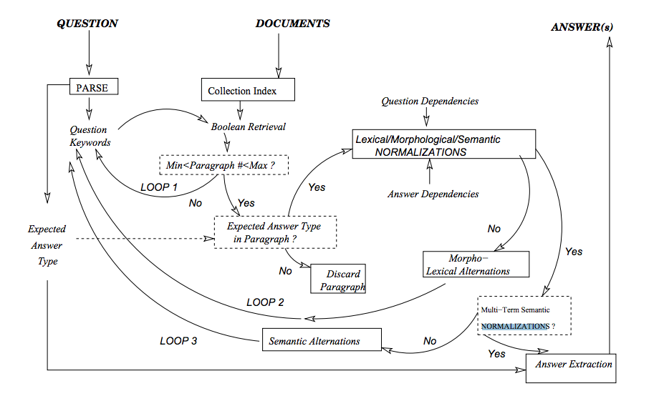

Feedback Loops: FALCON

Slide 37
Feedback Loops: FALCON
Loop 1:
Do I have good keywords to represent the question?
Test:
No: If many passages are retrieved or if too few passages are retrieved.
Yes: Otherwise.
Action:
Make query less or more specific depending on the failure mode.

Slide 38
Feedback Loops: FALCON
Loop 2:
Do I have answer candidates that are likely to contain the answer?
Test:
No: If dependency structure of question and candidates don’t match.
Yes: Otherwise.
Action:
Add morphological alternations.
e.g., Who invented → + inventor
Add lexical alternations (synonyms).
e.g., How far is → + distance

Slide 39
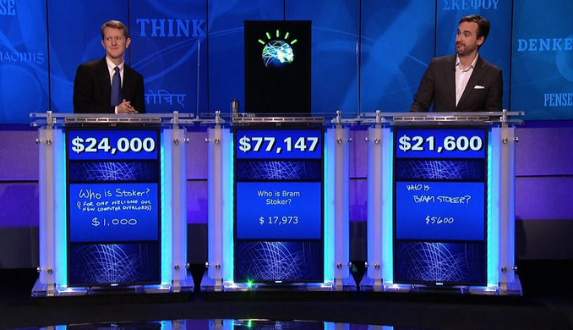
IBM Deep QA: Watson for Jeopardy!

Slide 40
What is Jeopardy?
EACH YEAR IT'S BLACK HISTORY MONTH
$200
Months of Year
SLUMDOG MILLIONAIRE IS SET IN THIS INDIAN CITY
$500
Recent Movies
IT'S THE THIRD-LARGEST STATE IN THE U.S. IN AREA
$300
US States
Each question comes with an assignment of points.
Whoever presses the buzzer first gets to answer.
Correct answer adds points, while incorrect or no answer results in a deduction.

Slide 41
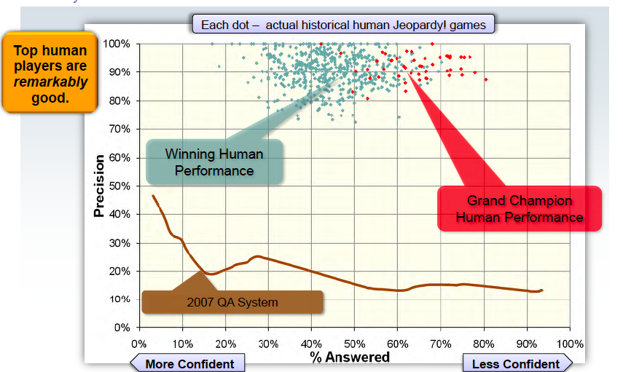
What kind of precision/recall trade-off is needed?
Best TREC-based QA system (2007) weren’t good enough.

Slide 42
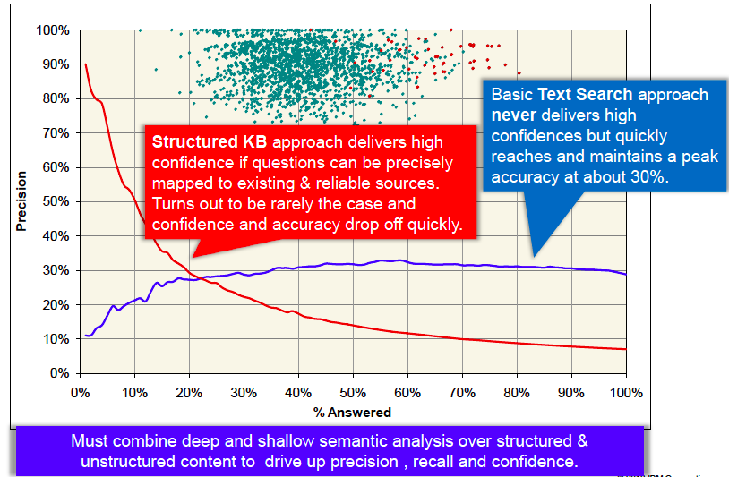
No single type of approach is going to do best!

Slide 43
Watson’s Approach
Approach
Generate several possible candidate answers (hypothesis).
Go back and find evidence supporting each candidate answer.
Use machine learning to combine evidence.
Key Design Decisions
Automatically generate knowledge.
Runtime answer type coercion.
Massively parallel architecture.
Tune nearly every component with machine learning.

Slide 44

How Watson Processes a Question
IN 1698, THIS COMET DISCOVERER TOOK A SHIP CALLED THE PARAMOUR PINK ON THE FIRST PURELY SCIENTIFIC SEA VOYAGE
Related Content
(Structured & Unstructured)
Keywords: 1698, comet,
paramour, pink, …
AnswerType(comet discoverer)
Date(1698)
Took(discoverer, ship)
Called(ship, Paramour Pink)
…
Question
Analysis
Primary
Search
Candidate Answer Generation
Taxonomic
Temporal
Lexical
Spatial
…
Isaac Newton
[0.58 0 -1.3 … 0.97]
Wilhelm Tempel
[0.71 1 13.4 … 0.72]
HMS Paramour
[0.12 0 2.0 … 0.40]
Christiaan Huygens
[0.84 1 10.6 … 0.21]
Edmond Halley (0.85)
Christiaan Huygens (0.20)
Peter Sellers (0.05)
Halley’s Comet
[0.33 0 6.3 … 0.83]
Edmond Halley
[0.21 1 11.1 … 0.92]
Pink Panther
[0.91 0 -8.2 … 0.61]
Merging &
Ranking
Peter Sellers
[0.91 0 -1.7 … 0.60]
44
…
Evidence
Retrieval
44
Evidence
Scoring

Slide 45




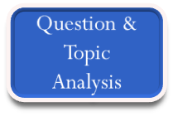
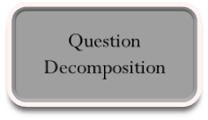
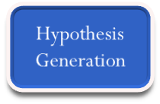
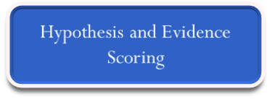

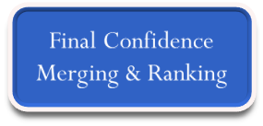


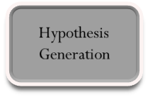

Watson’s Architecture: An Empirical Researcher’s Nightmare!
Learned Models
help combine and weigh the Evidence
Evidence Sources
Answer Sources
Models
Models
Question
Evidence
Retrieval
Evidence Scoring
Models
Models
Primary
Search
Candidate
Answer
Generation
Models
Models
Synthesis
Hypothesis and
Evidence Scoring
Merging &
Ranking
Answer & Confidence
. . .

Slide 46
Question Decomposition
Parallel Decomposable Questions
This company with origins dating back to 1876 became the first U.S. company
to have 1 million stockholders in 1951.
Q1 This company with origins dating back to 1876
Q2 The first U.S. company to have 1 million stockholders in 1951
Nested Decomposable Questions (Inner/Outer evaluation)
A controversial 1979 war film was based on a 1902 work by this author
(Q1 (Q2 A controversial 1979 war film) was based on a 1902 …)

Slide 47
Watson’s Architecture: An Empirical Researcher’s Nightmare!
Learned Models
help combine and weigh the Evidence
Evidence Sources
Answer Sources
Models
Models
Question
Evidence
Retrieval
Evidence Scoring
Models
Models
Primary
Search
Candidate
Answer
Generation
Models
Models
Synthesis
Hypothesis and
Evidence Scoring
Merging &
Ranking
Answer & Confidence
. . .

Slide 48
Candidate Search
Clue
Output:
Candidate Passages
+
Candidate Relations
DBPedia
PRISMATIC
Unstructured
[Encyclopedia]
[News Wire]

Slide 49
Candidate Search
Clue
Unstructured Query Generator
Two types of retrieval algorithms.
Indri Passage Retrieval
Retrieve passages that are highly relevant for the question.
Filter Wikipedia articles whose titles match query terms (w/ a dictionary lookup).
Modify scoring function to account for coverage of terms.
Recall query-likelihood model?
Indri
Passage
Retrieval
Lucene
Two-Stage
Retrieval
Title-in-Clue
Subset
Relevant Documents
Simple Filter
Unstructured
[Encyclopedia]
[News Wire]

Slide 50
Candidate Search
Clue
Unstructured Query Generator
Two types of retrieval algorithms.
Lucene Passage Retrieval
Retrieve “relevant” documents first and then retrieve passages.
Modify scoring to favor:
Sentences appear closer to the beginning.
Longer sentences.
Many anchor texts and document titles (to mimic named entities).
Indri
Passage
Retrieval
Lucene
Two-Stage
Retrieval
Title-in-Clue
Subset
Relevant Documents
Simple Filter
Unstructured
[Encyclopedia]
[News Wire]

Slide 51
Candidate Search
Clue
Unstructured Query Generator
Query Generation
Content terms and phrases identified in the question analysis.
Terms are weighted in relation to focus.
Recognize relations involving focus term.
Terms that are in focus relations weighted more.
Many corner cases exist (e.g., LAT only queries).
Indri
Passage
Retrieval
Lucene
Two-Stage
Retrieval
Title-in-Clue
Subset
Relevant Documents
Simple Filter
Unstructured
[Encyclopedia]
[News Wire]

Slide 52
Candidate Search
Clue
Answer Lookup:
Mainly for handling part of a question.
e.g., Redford and Newman starred in this grifter flick
=> actorIn(Redford, flick)
PRISMATIC:
Handles lexical relations about the focus.
e.g., Find the top instances that are sense organs.
Structured Query Generator
Relation(Named entity, Focus)
Isa(?, Focus)
Answer Lookup
PRISMATIC
Search
DBPedia
PRISMATIC

Slide 53
Candidate Generation
Type restricted candidate generation systems were too restrictive.
Even as many 200 types were found to be restrictive.
Instead try generating candidates first and then use type coercion to score.
Candidates from Unstructured Sources:
Title of document
Title of documents that best match the facts mentioned in the clue.
Retain provenance information (i.e., the document).
Wikipedia Title Candidate
95% of the answers were Wikipedia titles.
Identify words/phrases that are Wikipedia page titles but not subsumed.
Anchor Text Candidates
Metadata of the Wikipedia pages from which the passage was retrieved.
Anchor texts in the passage.
Candidates from Structured Sources:
The non-query portion of the relation is the candidate.
e.g., Who killed Lincoln? → Query Relations: (_, killed, Lincoln), (_, assassinated, Lincoln)
Answer candidates:
(Booth, killed, Lincoln)
(Booth, assassinated, Lincoln)

Slide 54
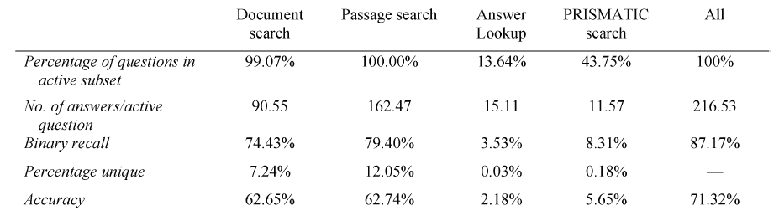
Candidate Generation Evaluation
Most failures due to extraneous terms that are not relevant to finding the answer.

Slide 55
Watson’s Architecture: An Empirical Researcher’s Nightmare!
Learned Models
help combine and weigh the Evidence
Evidence Sources
Answer Sources
Models
Models
Question
Evidence
Retrieval
Evidence Scoring
Models
Models
Primary
Search
Candidate
Answer
Generation
Models
Models
Synthesis
Hypothesis and
Evidence Scoring
Merging &
Ranking
Answer & Confidence
. . .

Slide 56
Evidence Retrieval and Scoring
Motivation:
Passages must match question in terms of content and syntactic structure.
Initial retrieval is not often adequate
Passages will match content words
Not necessarily exhibit structure similar to the question/clue.
Candidate + Question
Proposition
Answer Scoring
Term Matching
Skip-gram Matching
Textual Alignment
Structure Matching
Search
Evidence Passages
Retrieved using the same method as before but w/ the candidate answer included.

Slide 57
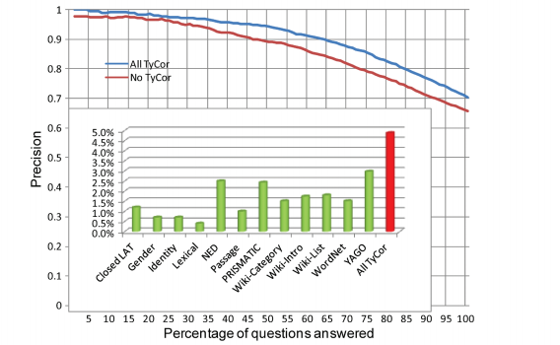
Type Coercion in Watson
Clues (qns) have expected answer types: Lexical Answer Types
Candidate answers are essentially strings.
Type Coercion or TyCor is used to check if the candidate answer’s type is compatible with LAT.
Several sets of structured sources are used: E.g., YAGO, Pronoun Checker, Closed LAT such as cities, NED, WordNet
Many other sources are used: E.g., Wiki-category, Wiki-List, Wiki-Intro sentence or passages
Given the candidate answer, use entity disambiguation to retrieve possible types from these sources.
Do the same for the lexical answer type.
Compute alignment between the types.

Slide 58
Watson’s Architecture: An Empirical Researcher’s Nightmare!
Learned Models
help combine and weigh the Evidence
Evidence Sources
Answer Sources
Models
Models
Question
Evidence
Retrieval
Evidence Scoring
Models
Models
Primary
Search
Candidate
Answer
Generation
Models
Models
Synthesis
Hypothesis and
Evidence Scoring
Merging &
Ranking
Answer & Confidence
. . .

Slide 59
Answer Merging
Often the same answer comes in many variants.
Splits evidence across these variants.
Classifier might be trying to distinguish between these variants.
Idea is to detect what are equivalent answers and merge them.
Detection involves a bunch of morphological, and table lookup mergers.
One has to also select the correct canonical form for the equivalent answers.
E.g., JFK vs. JFK International Airport
Choose the textual form that has the best support.
Feature Merging is done via any aggregate method.
Decay sum works the best as it distinguishes the case where
few strong evidences are better than multiple weak evidences.

Slide 60
Answer Ranking
Use Logistic Regression for ranking.
Well do classification and use the probability of relevance as ranking score.
Many ML issues arise.
Class imbalance → Do instance weighting.
Per query feature distribution → Normalize feature values per clue.
Few examples for some question classes → Transfer learning
Missing feature values versus zero → Impute (i.e, add a MISSING value).
Evidence Diffusion
Candidate answers can sometimes contain related words.
E.g., Pyongyang and North Korea can both be answers for a query about the country in which Sunan International Airport is located.
If we have evidence for Pyongyang then we have some “diffused” evidence for North Korea.
The idea here is to learn a weighted combination of original + diffused features.

Slide 61
Watson Summary
Impressive feat beating Human on a challenging task.
Key take-homes:
A huge system with multiple stages.
Multiple representations and approaches used in every stage.
Every component is tuned to optimize some internal + end metric.
Explicit evidence collection is a key distinguishing feature.
Type coercion is also a key component for success.
Currently IBM is looking to convert Watson to do useful things ☺.

Slide 62
Recap
What (I think) we covered
in class
Other cool NLP stuff
Language modeling
Text classification
POS tagging
Syntactic parsing
Entity recognition
Relation extraction
Event extraction
Information retrieval
Question answering
Semantic role labeling
Semantic parsing
Machine translation
Summarization
Speech recognition
Textual entailment
Discourse relations
…
…
Also a bit about how to model a task as a ML problem.

Slide 63
Language Modeling
Probability of word sequences
Maximum likelihood estimation
Zero probability issue.
Smoothing techniques.
Steal from the haves and give it to the have-nots.
Add-1
Perplexity

Slide 64
Classification
Spam/Ham, Document Categorization etc.
Bayesian Classifier
Generative
Maximum Entropy Classifier
Discriminative
Find parameters that maximize the likelihood of the data.
Use gradient descent for optimization.

Slide 65
POS Tagging
Sequence modeling task.
Input: Sequence of words
Output: Sequence of tags.
Hidden Markov Models
Transition probabilities
Emission probabilities
Viterbi Decoding
Supervised Approach
Learn probabilities from training data.
Unsupervised Approach
Use Expectation Maximization.

Slide 66
Parsing
Extract syntactic structure in text.
Constituency
Probabilistic Context Free grammar
MLE estimation of rules.
CYK Parser with dynamic programming decoding.
Dependency
Transition-based Parsing
Predict one of four actions.

Slide 67
Information Extraction
Named entity recognition
HMM
MEMM
Fine-grained models (FIGER)
Relation extraction
Bootstrapping
Supervised
Distant supervision
Event Extraction
Supervised pipeline
Distant supervision
Discovering schemas

Slide 68
Information Retrieval
Finding documents that are relevant to a query.
Vector space models
Probabilistic Language Models
Learning to rank Models

Slide 69
Question Answering
Reading-based
Watson

Slide 70


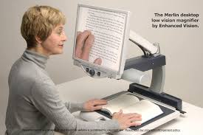
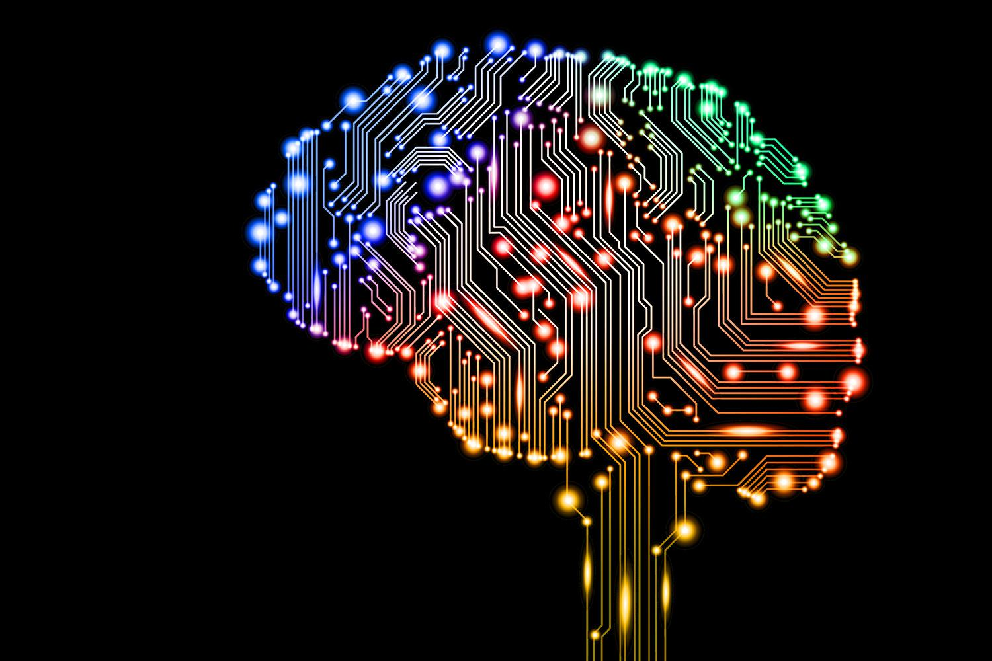
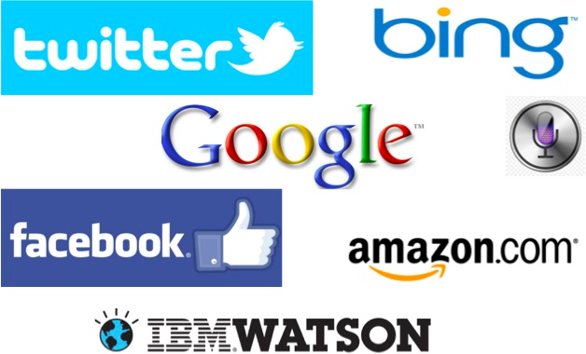
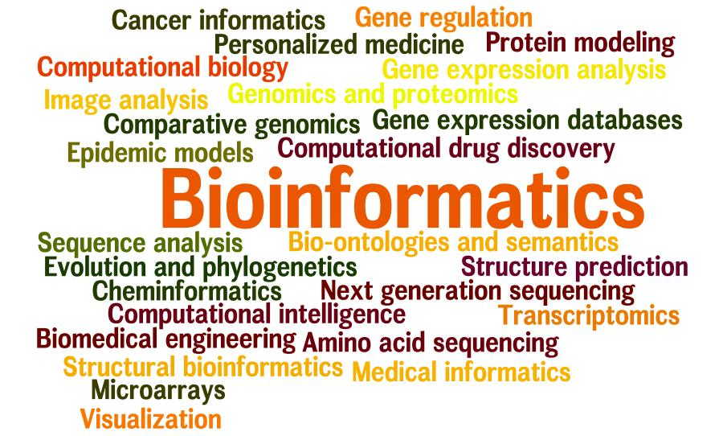
Do NLP.
Even if you aren’t swayed by what you saw in this awesome class,
you should be learning more about NLP and contribute to the field!
Come talk to me if you are interested in doing anything remotely NLP.
Assistive Technologies
Artificial Intelligence
Web Technologies
Science

